Slide 1
Approach Kubernetes(K8s) on GKE
automating computer application deployment the presentation of CHATBOT/BACS team

Slide 2

1. An introduction to Kubernetes and GKE 2. Kubernetes microservices overview 3. Kubernetes’s concepts we find out 4. Demo 1(using Deployment & Service) 5. An introduction to Helm & Traefik 6. Demo 2(using Helm + Traefik + Deployment + Service)

Slide 3
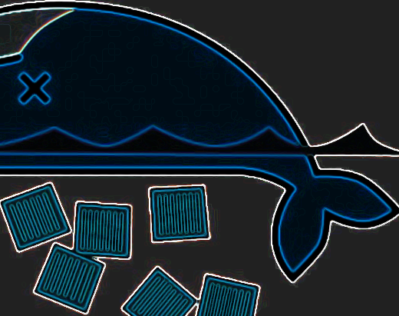
Health
Monitoring
Scaling
Security
Discovery
Configuration

Slide 4
why do we need K8s cluster?
Simplifying applications deployments
Simplifying monitoring, logging and debugging
Horizontal Pod Autoscaler(HPA)(automatically increase or decrease the number of Pods, based on metrics server and other parameters)
Vertical Pod Autoscaler(VPA)(It will kill your Pods and re-create with the resources[like RAM, CPU,…] up-to-date, based on metrics server, usage history, other parameters)
Cluster Autoscaler(CA)(dynamically add or remove Node to your cluster, based on metrics server and other parameters)
<< Right-click the hyperlink and select Open Hyperlink on the shortcut menu. >>

Slide 6
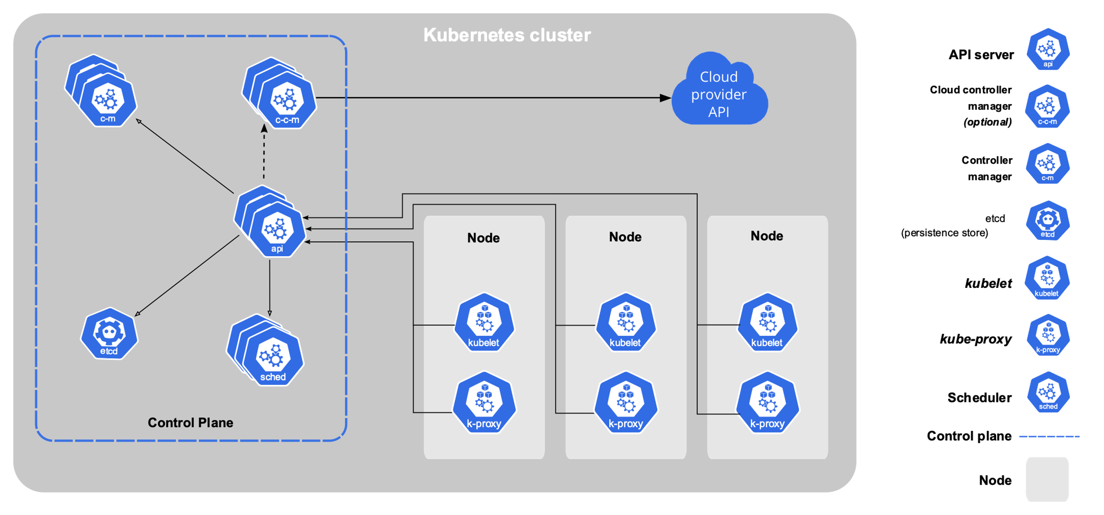
focus on Control Plane, it’s running on master, it’s a brain of K8s. <<< don’t run any application’s PODs on master >>>
components overview &
cluster architecture

Slide 7
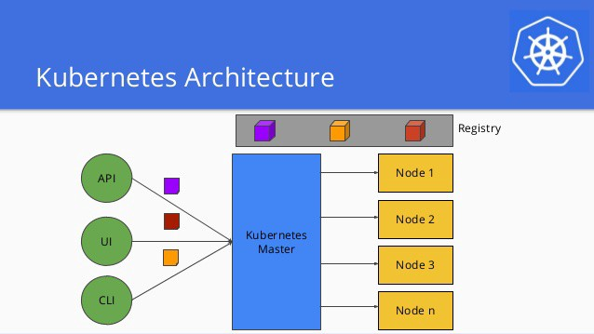
we just need to work with the master, and we can use web UI or CLI tool. K8s have a CLI tool, it’s kubectl.

Slide 8
work with kubectl & define manifest file
The Standardized Glossary(thuật ngữ)
Overview & the kubectl cheatsheet
syntax: kubectl [command] [TYPE] [NAME] [flags]
ex: kubectl apply –f nginx-deployment.yaml => (Apply a configuration change to a resource from a YAML file)
Manifest: specification of a Kubernetes API object in JSON or YAML format

Slide 9
how can I have K8s cluster?
On local, using Minikube(learning environment)
Using public cloud: GKE, Amazon EKS, Microsoft AKS, etc
Pros: they integrated many useful/advanced features in your control plane
Google’s new product: Anthos is a product that allows you run/manage GKE(or manage a cluster is not running on GKE) on multi-cloud or on-premises and your can leverage the power of GKE(deploy containerized apps from Google Cloud Marketplace, serverless with Cloud Run, Security, High available,…).
Install your cluster production environment by yourself
Installing Kubernetes with deployment tools
Using Rancher version 2.x to create your cluster quickly

Slide 10
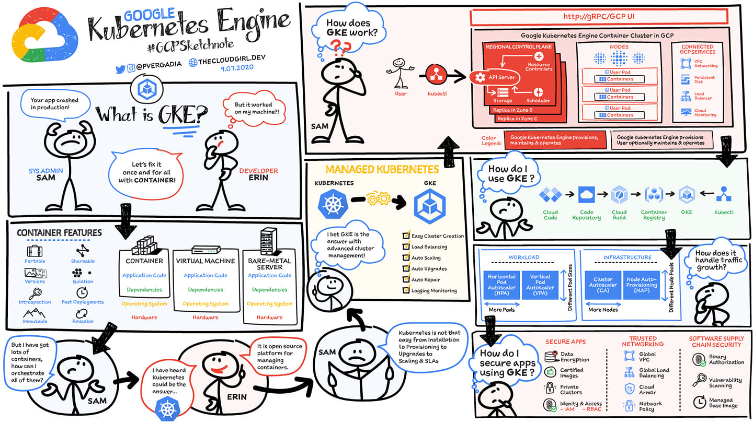

Slide 11
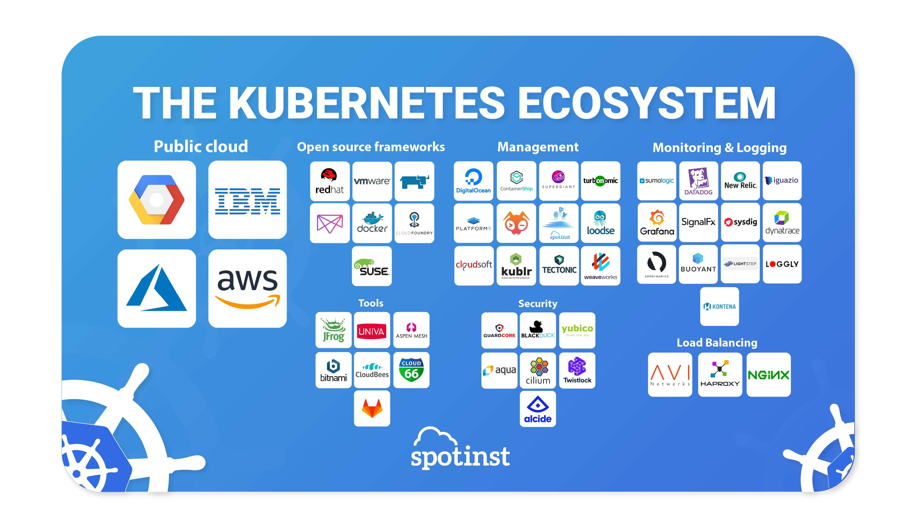

Slide 12
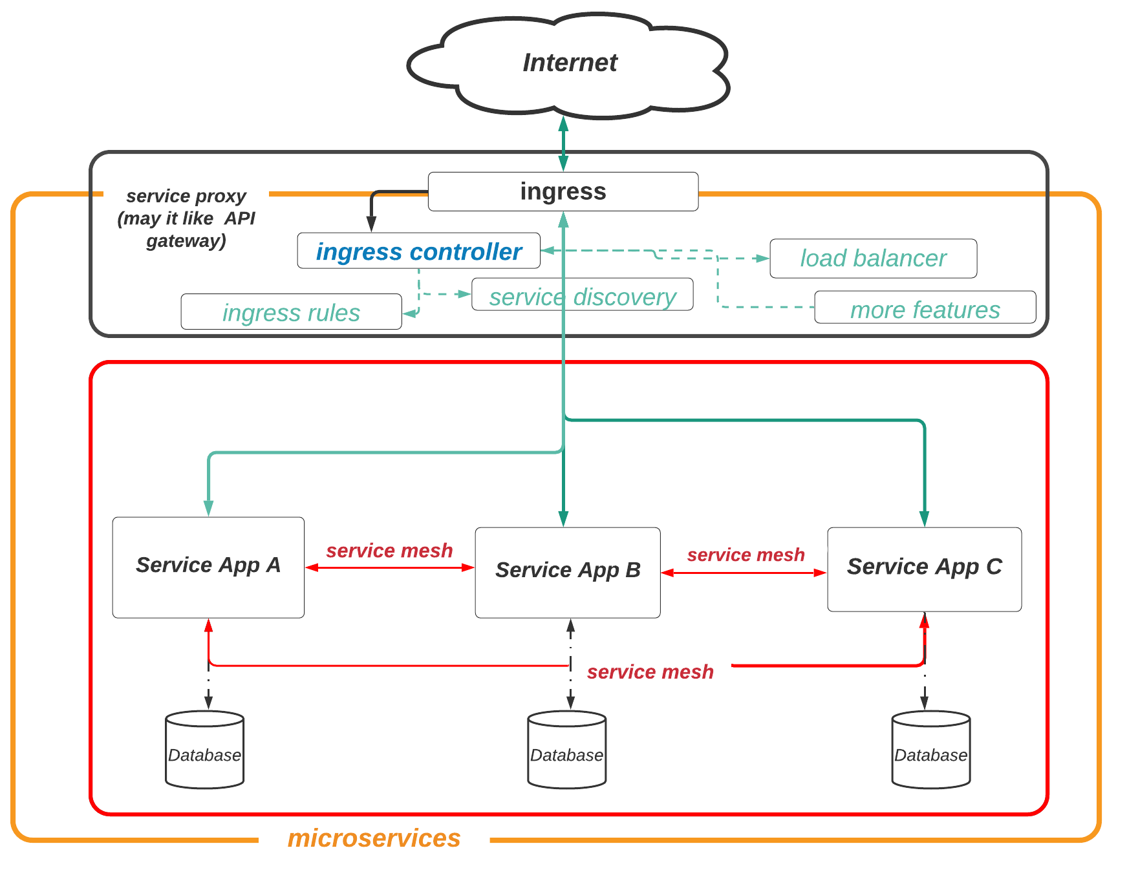
Kubernetes,
the basic of microservices architecture
domain.com/service-a
domain.com/service-b
domain.com/service-c

Slide 13
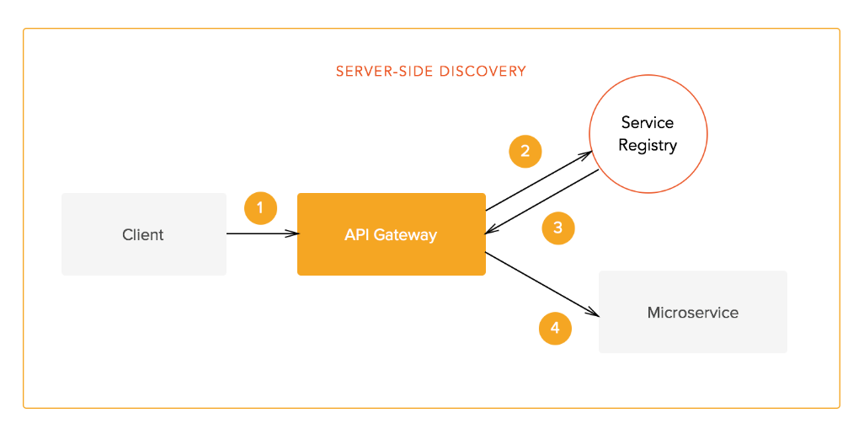
Service discovery
Have two patterns: server-side/client-side discovery
Service Registry(SR) is a very important part of service retrieval. It is a database that includes the network location of service entities, so instantaneous updating is always a high requirement.
Why do we need? dynamically assigned network locations, autoscaling, failures, and upgrades, etc. We need to know any changes(like IPs, healthy status, etc)

Slide 14
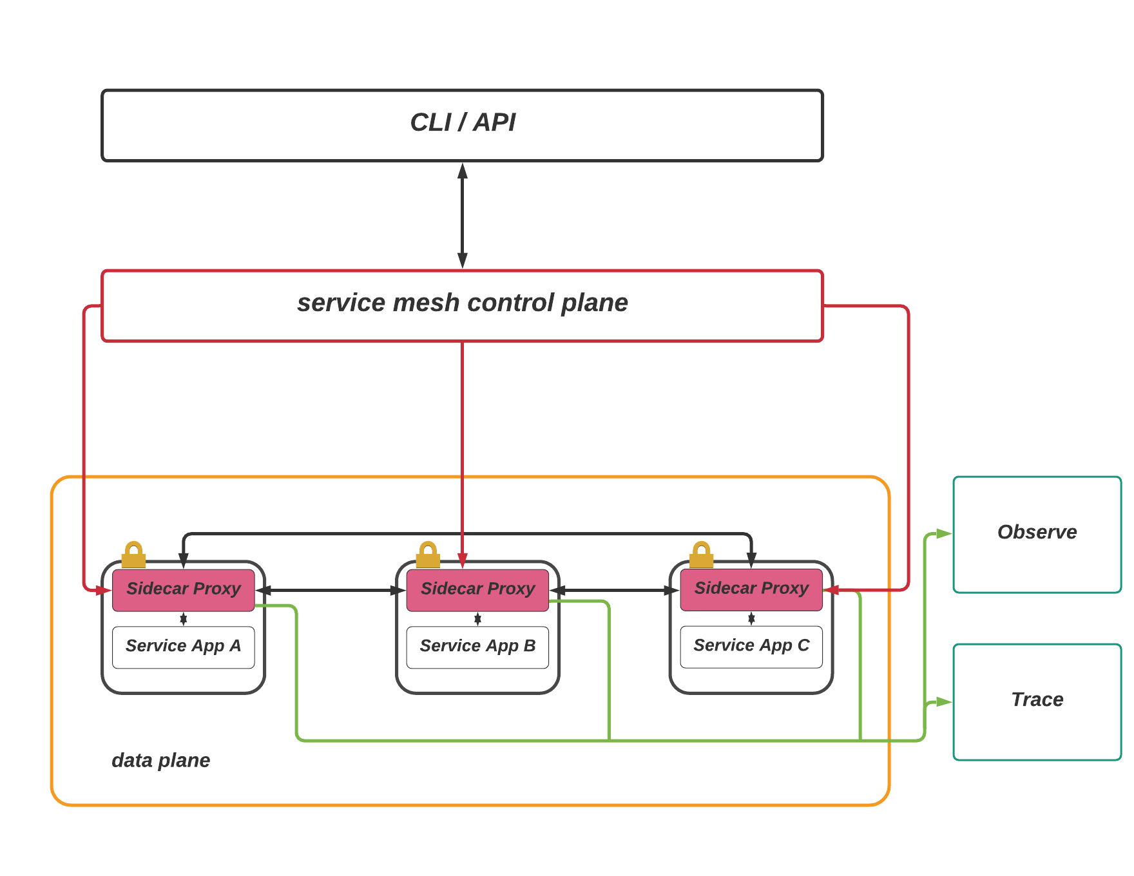
Service Mesh architecture
Some Service Mesh software
Istio: project was started by teams from Google and IBM, in partnership with the Envoy team at Lyft), it is also integrated into GKE(link)
AWS App Mesh, Consul Connect, etc
You can check Service Mesh Landscape

Slide 15
some K8s‘s concepts we find out
Workloads > Pods
Deployments(a part of Workloads > Controllers)
Services(a part of Services, Load Balancing, and Networking)
Ingress > Ingress controller(a part of Services, Load Balancing, and Networking)

Slide 16
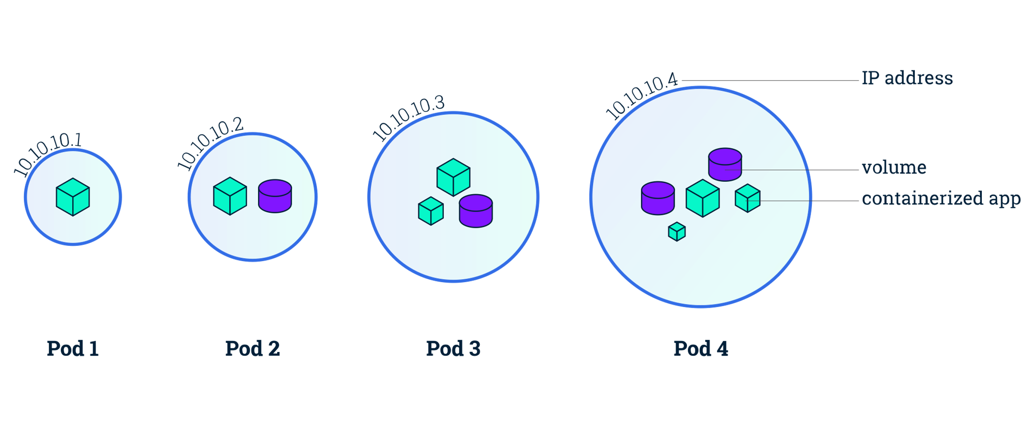
For a Pod must contain at least 1 container

Slide 17
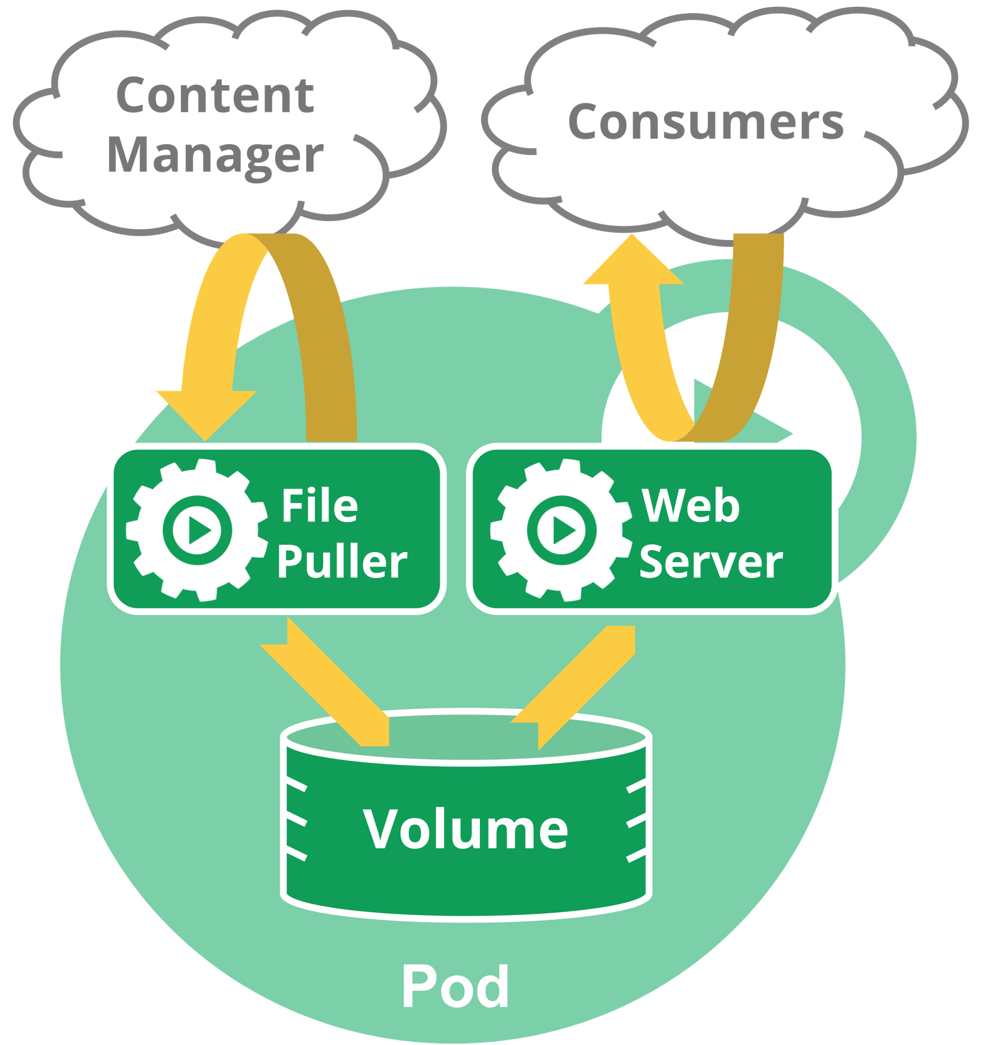
Workloads/Pods
Pods are the smallest deployable units of computing that you can create and manage in Kubernetes.
Container vs Pods:
Container is a single application on running
In practice we might need to run some parallel containers with the main container application, so K8s will group all those containers into a Pod and manage it.
How to define a Pod in manifest?
define a YAML manifest file with(link) kind: Pod

Slide 19
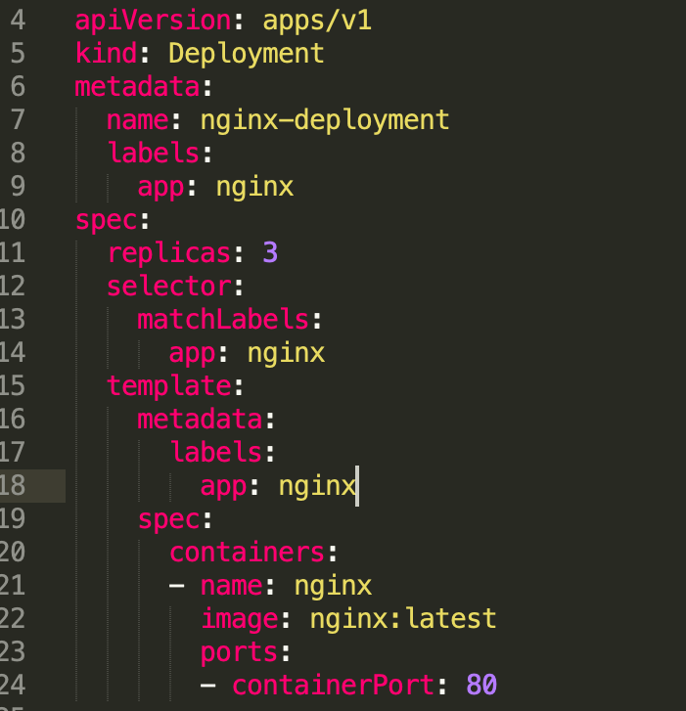
Deployments
Provides a way to deploy, update and manage Pods
Deployment will create two main components Pods & ReplicaSets
ReplicaSets: A ReplicaSet's purpose is to maintain a stable set of replica Pods running at any given time. Simple understanding, will increase or decrease the number of Pods(HPA).
ex: you get low traffic, ReplicaSets will kill some Pods, or with high traffic it increase the number of Pods
How to define a Deployment in manifest?
- define a YAML manifest file with(link) kind: Deployment

Slide 20
Services
The main life cycle of Pods after creating is running or terminating.
If we use a Deployment, it can create and destroy Pods dynamically.
And your Pod will get another IP address after re-create, so we need a Service
Cloud-native service discovery
we can query the API server for Endpoints, that get updated whenever the set of Pods in a Service changes.
This API allows services such as the Ingress controller to use the data for its Service Discovery
How to define a Service in manifest?
- define a YAML manifest file with(link) kind: Service
Publishing Services(ServiceTypes)
ClusterIP: Exposes the Service on a cluster-internal IP, Service only reachable from within the cluster
NodePort: as a ClusterIP, but you'll be able to contact the NodePort Service, from outside the cluster, by requesting <NodeIP>:<NodePort>
LoadBalancer: Exposes the Service externally using a cloud provider's load balancer.

Slide 21
Zero Downtime with Rolling Updates
Please check the gif picture to see how to K8s will be using Rolling Update
Some specific cases, we need to do more to make sure your container inside the Pod can handle its work
Reading

Slide 22
Ingress & Ingress Controllers
Ingress exposes HTTP and HTTPS routes from outside the cluster to services within the cluster. Traffic routing is controlled by rules defined on the Ingress resource.
An Ingress may be configured to give Services externally-reachable URLs, load balance traffic, terminate SSL/TLS, and offer name-based virtual hosting
For an Ingress resource to work, the cluster must have an ingress controller running.
Ingress controllers are not started automatically with a cluster, we need implementation with an Additional controller
Different Ingress controller support different annotations. Review the documentation for your choice of Ingress controller to learn which annotations are supported.

Slide 23
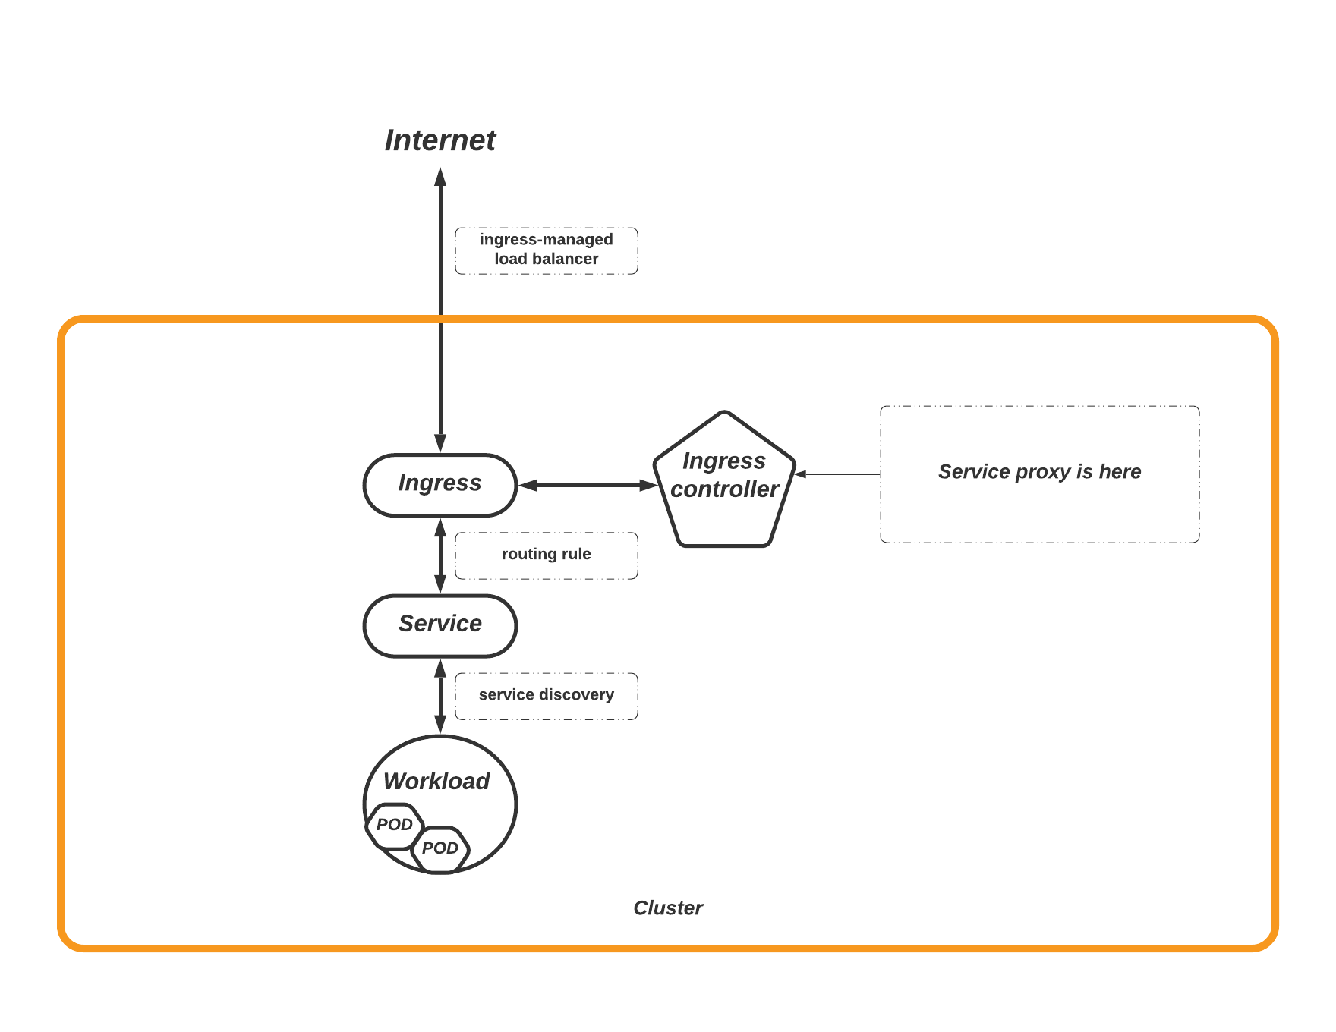




Slide 24
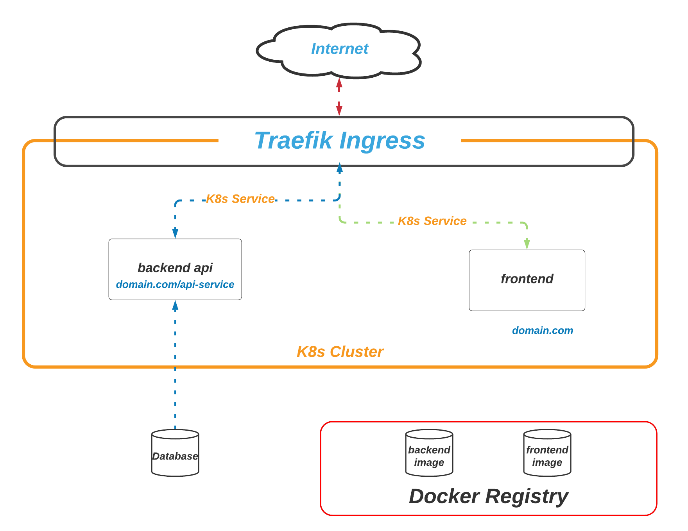
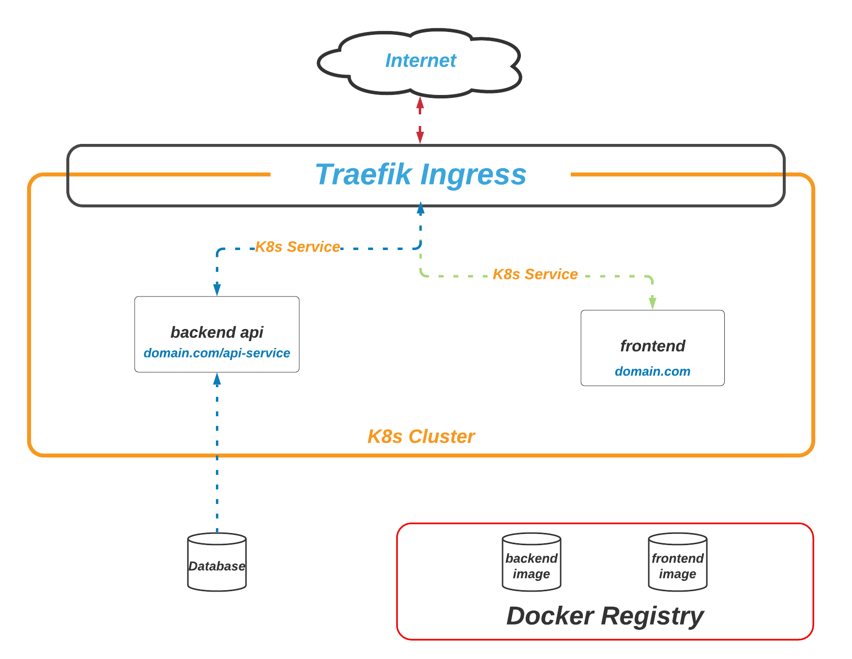

Slide 25
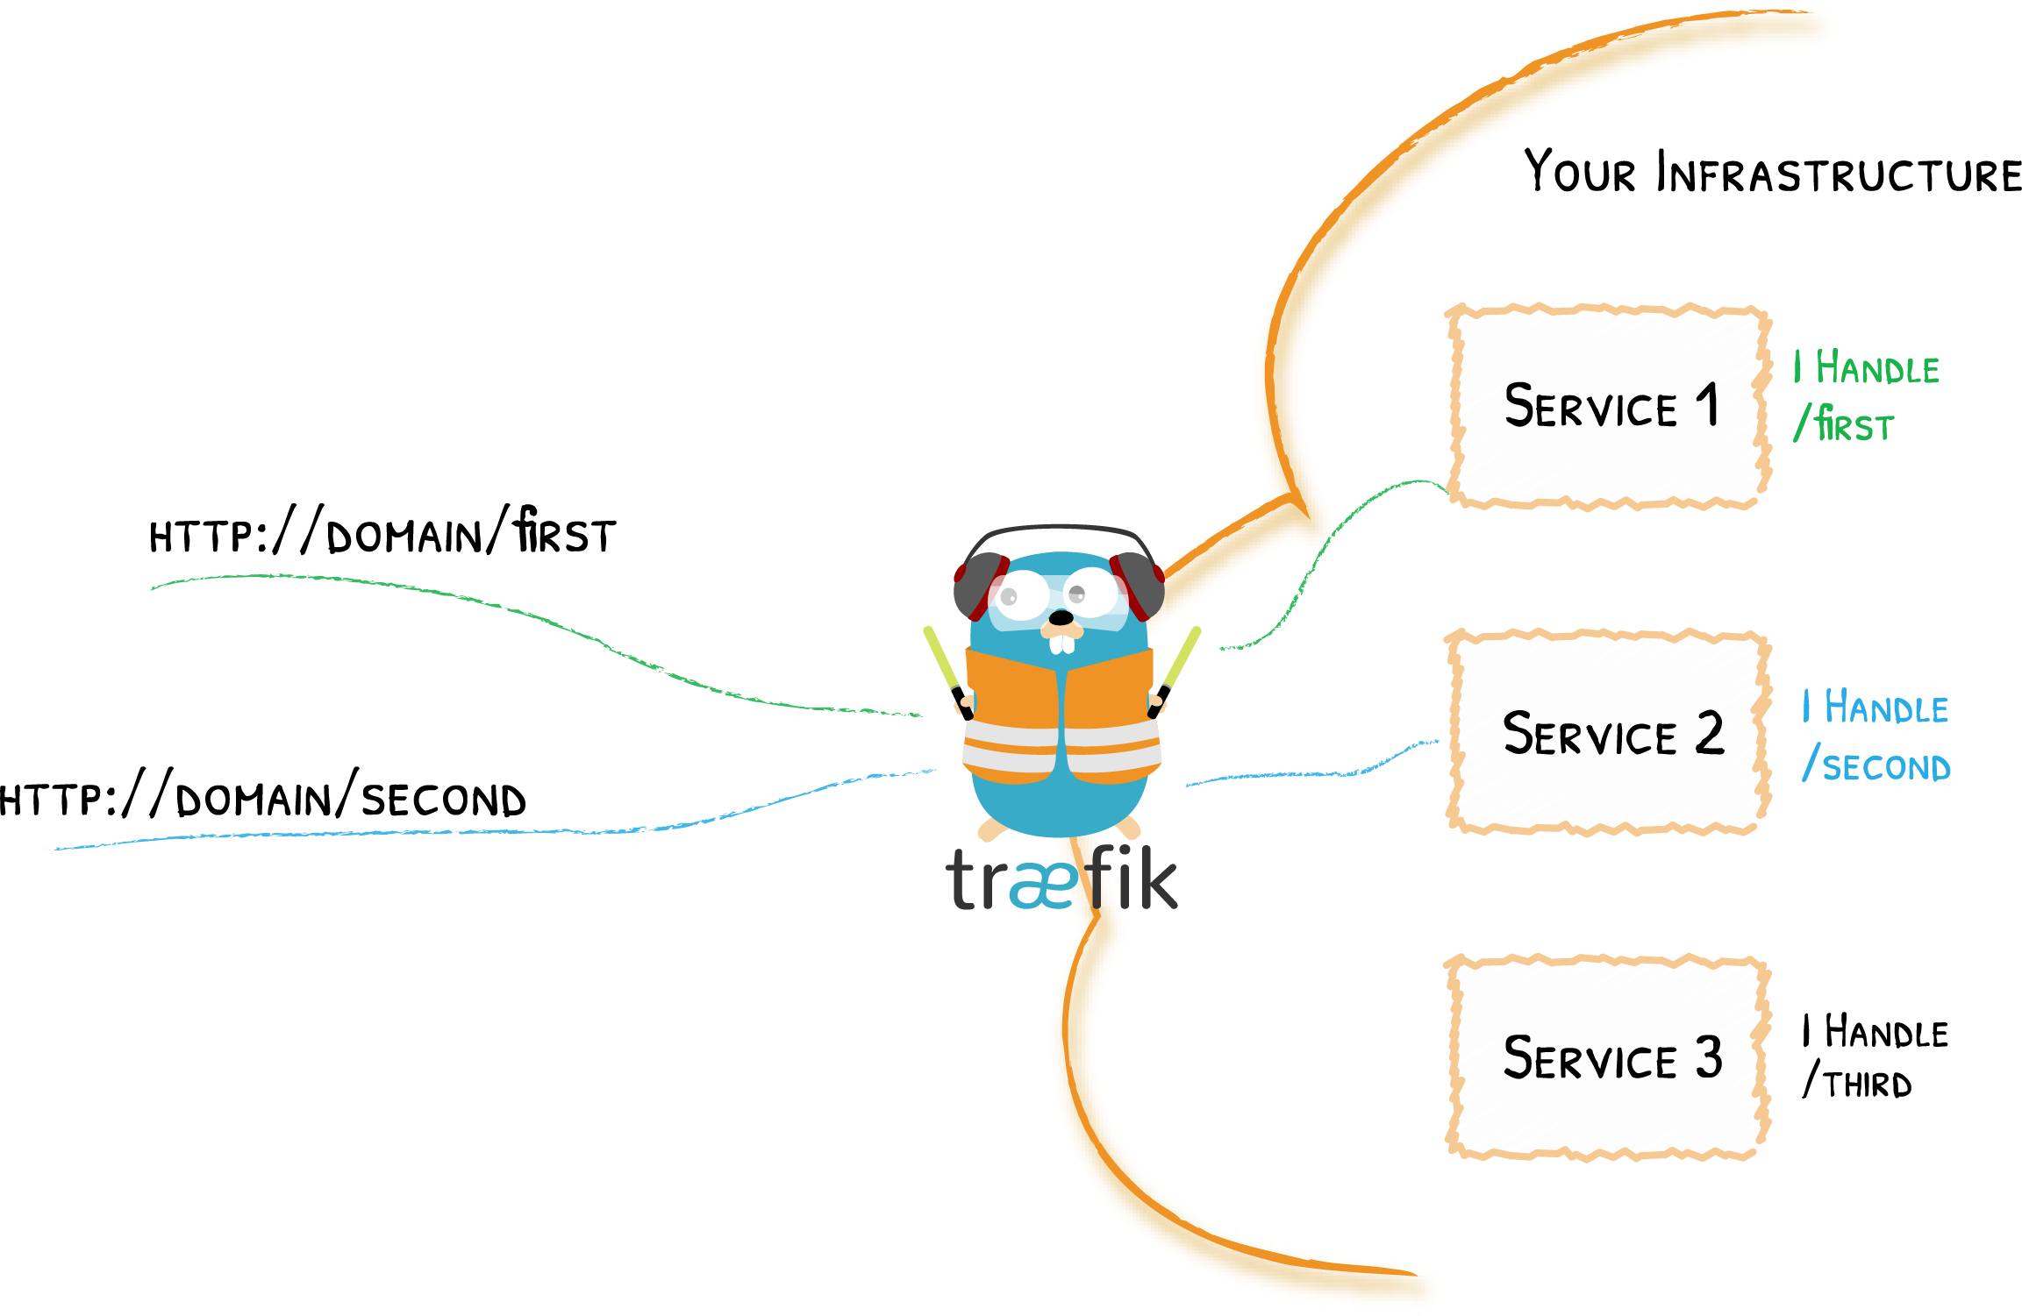
Traefik Proxy
Traefik Proxy is an additional controller for K8s
Traefik(call traffic) is a Reverse-proxy for microservices, also a load balancer, make microservices deployment process easier
Main Concepts:
Edge Router: intercepts and routes every incoming request, knows all the logic and every rule that determine which services handle which requests (based on the path, the host, headers, and so on...)
Auto Service Discovery
Two way to define an Ingress
Use Ingress Controller(docs link)(that mean it manages access to a cluster services by supporting the Ingress specification)
Use Custom Ingress Controller(docs link), they were written a Custom Resource Definition(CRD) for an IngressRoute type, it was supporting the Traefik specification
Some features
Routing & load balancing
Security with Let’s Encrypt support & Custom certificates, etc
Dynamic Configuration & Observability

Slide 26

Helm is a package manager for Kubertenes - Helm, by making application deployment easy, standardized and reusable, reduces deployment complexity, etc
You don’t want to define many K8s's resources
Use cases of helm
Concepts
Helm package is called Chart, it is a collection of YAML files
Config: in the values.yaml file contains the configuration specific to a release of the Kubernetes application. This can be a configuration for service, ingress, and deployment
Release: is a version of the K8s application running Chart-based and associated with a specific Config.
Repository(Helmhub) is the place where charts can be collected and shared(at helm hub, a chart start with stable/[AppName] is a Stable Chart, Stable Charts meet the criteria in the technical requirements & Verification)

Slide 27
Using Traefik helm chart(link)
By default the Traefik helm chart has exposed for us two ports:
Port 80 with --entrypoints.<name> is web
Port 443 with --entrypoints.<name> is websecure
Visit link for more information about Configure ports
Source code
Athe file values.yaml, we can customize the installation by specifying custom values, as with any helm chart Install with helm install --values=./custom-values.yml traefik traefik/traefik
Installing & Deploying Traefik

Slide 28

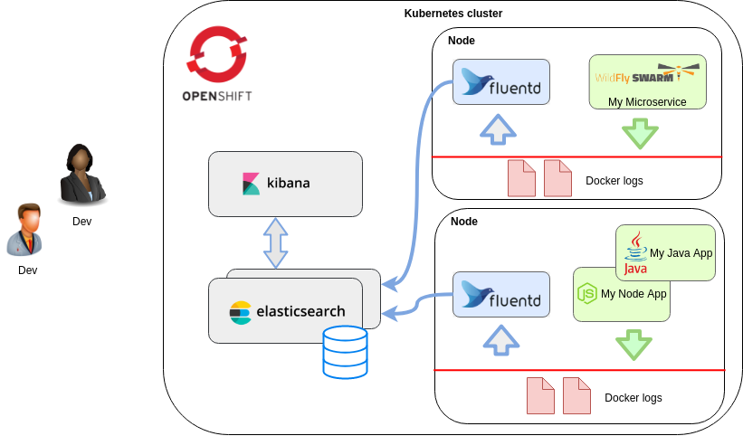
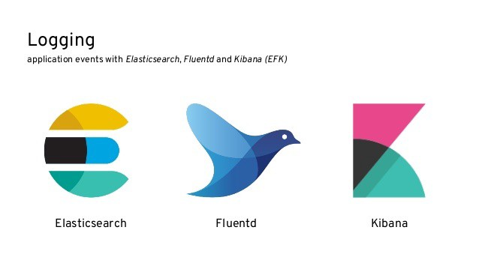
Use Google Click to Deploy to deploy EFK logging stack

Slide 29
In conclusion, to start with K8s you need to learn about
Docker/CRI-O knowledge
Workloads/Pods knowledge
Services knowledge
Ingress and an Additional controller of your choice
Choose a K8s cloud platform to build your application
Helm / Learn day-by-day

Slide 30
other concepts you should researching
Self-healing
Storage orchestration
Automated rollouts and rollbacks
Automatic bin packing
Secret and configuration management
Role-based access control(RBAC)
The Kubernetes API & Working with Kubernetes Objects
Metrics Server(collect the parameters about RAM, CPU, Network, etc. Must be installed it on your cluster for auto scaler)
Custom Resources Definition(CRD)
<< Concepts overview >>

Slide 31
at the end of the presentation
thank you all!

